Slide 1
Data Preprocessing
Arshveer Kaur

Slide 2
Definitions
Data
Collection of data objects and their attributes
Attribute
Property or characteristic of an object

Slide 3
Properties of Attributes
Distinctness : = ≠
Order : < >
Addition : + -
Multiplication : * /

Slide 4
Types of Attributes
Nominal
Examples: ID numbers, eye color, zip codes
Ordinal
Examples: rankings (e.g., taste of potato chips on a scale from 1-10), grades, height in {tall, medium, short}
Interval
Examples: calendar dates, temperatures in Celsius or Fahrenheit.
Ratio
Examples: temperature in Kelvin, length, time, counts

Slide 5
Why do we need Data Pre-processing
Real Data can be:
Incomplete: lacking attribute values, lacking certain attributes of interest, or containing only aggregate data
Noisy: containing errors or outliers
Inconsistent: containing discrepancies in codes or names

Slide 6
Data Cleaning
Handling missing values
Eliminate Data Objects
Estimate Missing Values
Ignore the Missing Value During Analysis
Handling outliers and noisy data
Binning
Clustering
Correct inconsistent data
Resolve redundancy caused by data integration

Slide 7
Binning
Sorted data (e.g., by price)
4, 8, 9, 15, 21, 21, 24, 25, 26, 28, 29, 34
Partition into (equi-depth) bins:
Bin 1: 4, 8, 9, 15
Bin 2: 21, 21, 24, 25
Bin 3: 26, 28, 29, 34
Smoothing by bin means:
Bin 1: 9, 9, 9, 9
Bin 2: 23, 23, 23, 23
Bin 3: 29, 29, 29, 29
Smoothing by bin boundaries:
Bin 1: 4, 4, 4, 15
Bin 2: 21, 21, 25, 25
Bin 3: 26, 26, 26, 34

Slide 8
Sampling
Sampling is used in data mining because processing the entire set of data of interest is too expensive or time consuming.
The key principle for effective sampling is the following:
Using a sample will work almost as well as using the entire data sets, if the sample is representative
A sample is representative if it has approximately the same property (of interest) as the original set of data

Slide 9
Types of Sampling
Simple Random Sampling
There is an equal probability of selecting any particular item
Sampling without replacement
As each item is selected, it is removed from the population
Sampling with replacement
Objects are not removed from the population as they are selected for the sample.
In sampling with replacement, the same object can be picked up more than once
Stratified sampling
Split the data into several partitions; then draw random samples from each partition

Slide 10
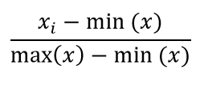

Normalization
Min –Max Normalization
Z-score Normalization
A common normalization method is to transform all the data to have zero mean and unit standard deviation:

Slide 11
Introduction to SPSS

Slide 12
SPSS
Software Package used for Statistical Analysis of data.
Produced by SPSS Inc. in 1968.
SPSS used to stand for “Statistical Package for the Social Sciences”
Later changed to “Statistical Product and Service Solutions”
Acquired by IBM in 2009. Now known as IBM-SPSS Statistics

Slide 13
Specialized packages
SPSS Data Collection (for surveys)
SPSS Modeler (for data mining)
SPSS Analytic Catalyst (for Big data) etc.

Slide 14
Benefits
Very rich collection of Statistical tests and methods
Outputs an extensive set of metrics and statistically important factors
Support available
Well known in non-CS fields

Slide 15

Features
Automation: Automatically prepares the data to give best results

Slide 16
Features
Scalable
Jython : Python + Java Functions
Modelling Techniques
Optimization
SQL
User Interface
Functions

Slide 17
Applications
Fraud Detection
Forecasting
Text Mining
Education
Medical

Slide 18
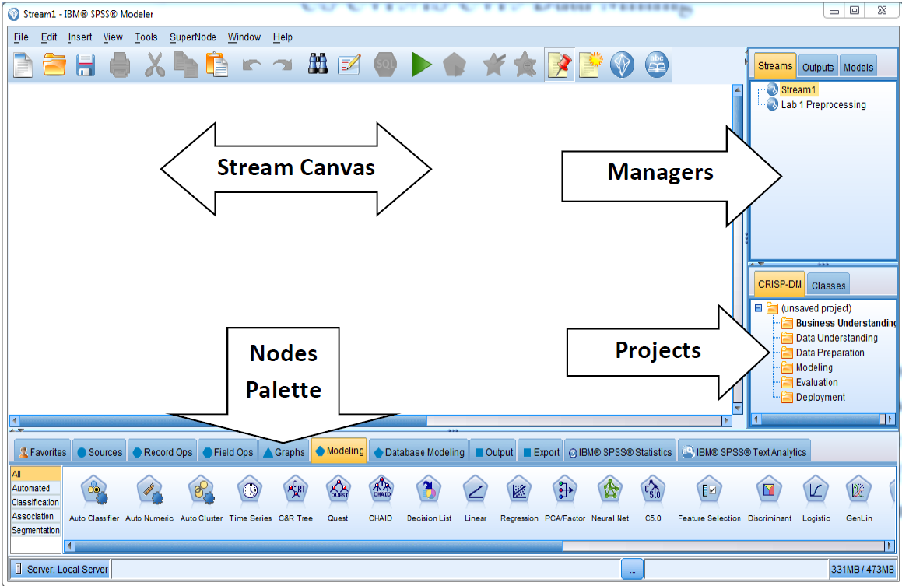
Modeler Main Stream space

Slide 19
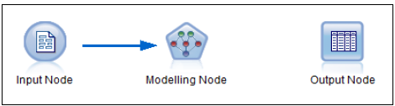
Basic Stream

Slide 20



Source Node

Slide 21




Record Operation Nodes
Select Sample Merge Sort

Slide 22




Field Operation Nodes

Slide 23




Output Nodes

Slide 24
Thank you

